Slide 1
QUANTUM TUNNELING
BY ADITYA SINGH
2K19/EP/005

Slide 2

SCHRODINGER EQUATION
Quantum mechanics differs from classical mechanics in the equation of motion and the required initial conditions.
A quantum particle is described not by its position and velocity, but rather by a complex function — called the wave function — spread out over all of space. Its motion (or change), in turn, is dictated by Schrödinger’s equation of motion:

Slide 3
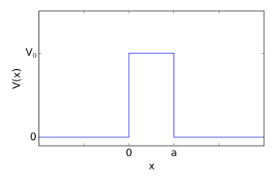



POTENTIAL BARRIER
Consider a one-dimensional potential barrier described by a potential
The time independent Schrödinger equation for the region 1 is:

Slide 4

The solution in region 3 is, naturally, very similar:

Slide 5

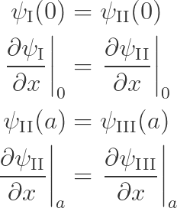
Finally, we can look at the region of space inside the potential barrier. While the potential here is still constant, it is non-zero. This, however, only results in a change of the wavenumber;
The continuity of the wave function and of its derivative yields four boundary conditions:

Slide 6
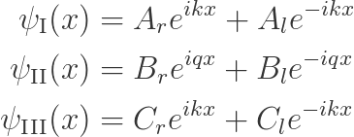
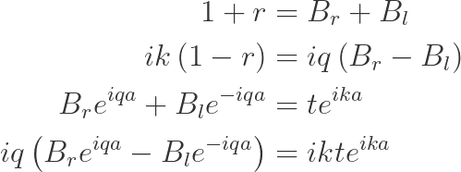


Slide 7

TUNNELING PROBABILITY
First, let us note that we care about the solution for a particle of energy lower than the potential barrier height . In such a case, we have that:
The tunneling probability is then calculated as:

Slide 8


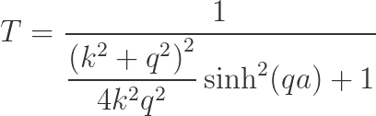

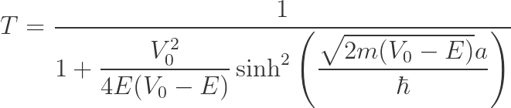

Slide 9
PYTHON SIMULATION
We will require the sparse package to represent sparse matrices, and the sparse.linalg module to manipulate them.
Discretize space using a uniformly spaced grid x of step dx.
Initialize the wave function as a Gaussian packet. We first prepare a Gaussian distribution then multiply by a complex exponential representing the initial momentum k0, and finally normalize.
Set up the potential as a zero array, except for the barrier which is located just to the right of the origin of the coordinate system.
We first compute the wave function at the next time step by applying the time evolution matrix to the previous wave function.

Slide 11
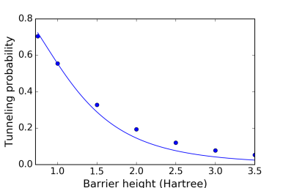
Part of the particle appears to tunnel through the barrier!
If we were to place a detector behind the barrier, it might measure the particle appearing behind it.

Slide 12
THANK YOU

